Slide 1
Creating a Healthy One Planet Community
Arrowsmith Naturalists
Parksville
25 September 2025
********************
Dr. Trevor Hancock
Retired Professor and Senior Scholar
School of Public Health and Social Policy
University of Victoria

Slide 2
Outline
The planetary crisis is real - and profound
  The polycrisis
We need to change:Towards a Wellbeing society
Implications for urban development
  One Planet communities
  Ecological impacts of different urban forms
  Healthy communities
Shouldn’t we be talking about this? Ideas for deepening democracy

Slide 3
1. The planetary crisis is real - and profound

Slide 4
Welcome to the Anthropocene
A geological phenomenon, a new geological epoch
An ecological phenomenon – massive and rapid global ecological change
A human phenomenon - we are the anthropos in the Anthropocene
  More precisely – SOME OF US are the anthropos in the Anthropocene

Slide 5
The Anthropocene – more than just climate change
Climate change
Ocean acidification
Ozone layer depletion
Resource depletion
  Renewable
  Non-renewable
Pollution
  Ecotoxicity
Species extinctions
ALL AT THE SAME TIME
This constitutes an existential challenge

Slide 6
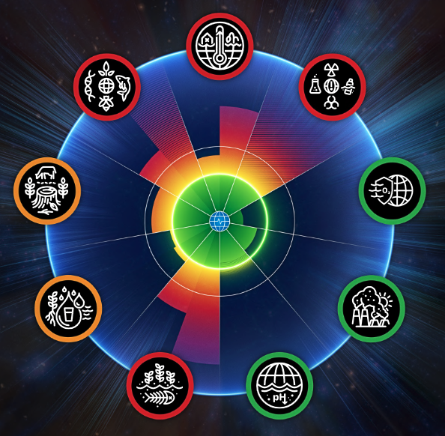
Planetary Health Check 2024

Slide 7
We have crossed 7 of 9 Planetary Boundaries
“The 2024 Planetary Health Check report reveals that six out of nine PB processes have breached the safe PB levels, with all six showing trends of increasing pressure in all control variables, suggesting further boundary transgression in the near future.”
Since then it has been announced we have crossed a seventh, Ocean Acidification.
Findlay, Feely, Jiang et al., 2025

Slide 8
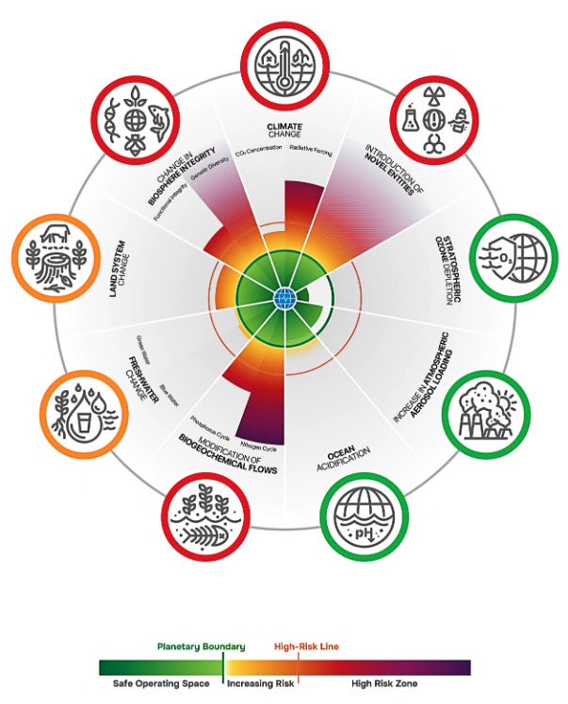

Slide 9
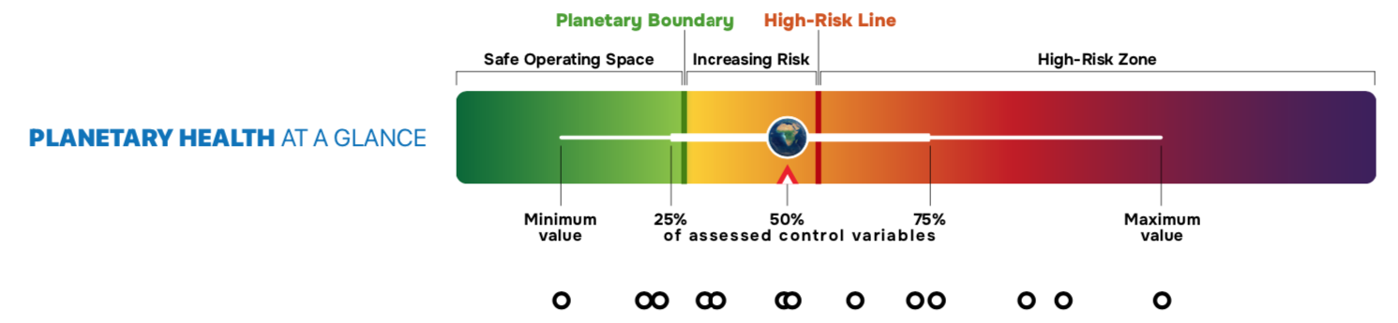
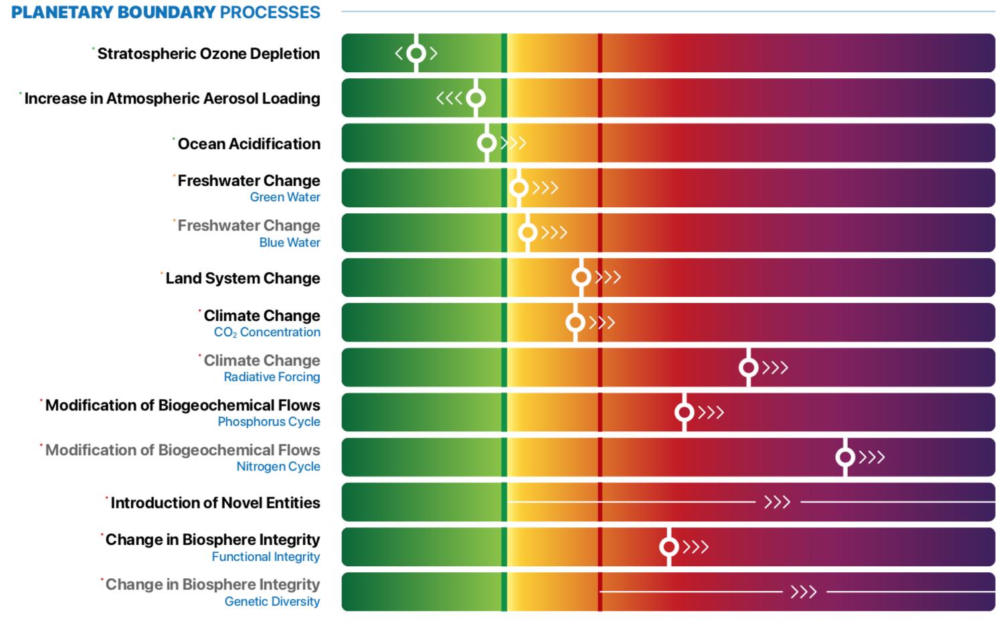
All these are getting worse

Slide 10
To put it bluntly!
“There are nine planetary boundaries and we’ve only dealt with one of them — the ozone layer — and we think we’ve saved ourselves from that threat. But we passed the seventh boundary this year, and we’re in the extreme danger zone. Rockström says we have five years to get out of the danger zone. If we pass one boundary, we should be shitting our pants. We’ve passed seven!”
David Suzuki
Interview in iPolitics
July 2nd, 2025
Notes:
https://www.ipolitics.ca/2025/07/02/its-too-late-david-suzuki-says-the-fight-against-climate-change-is-lost/

Slide 11
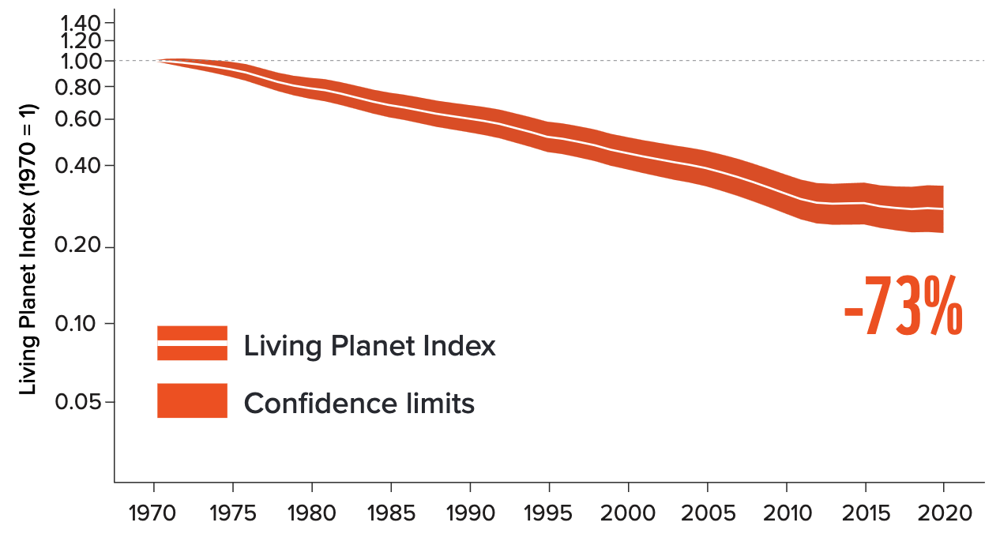
Living Planet Index 2020
Average size of monitored wildlife populations
Based on almost 35,000 population trends and 5,495
species of amphibians, birds, fish, mammals and reptiles
Global Living Planet Index
Living Planet Report, 2024
Notes:
https://wwflpr.awsassets.panda.org/downloads/2024-living-planet-report-a-system-in-peril.pdf

Slide 12
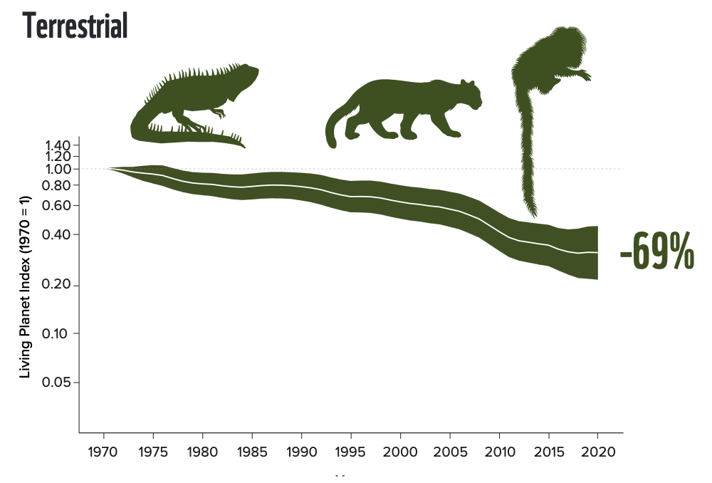
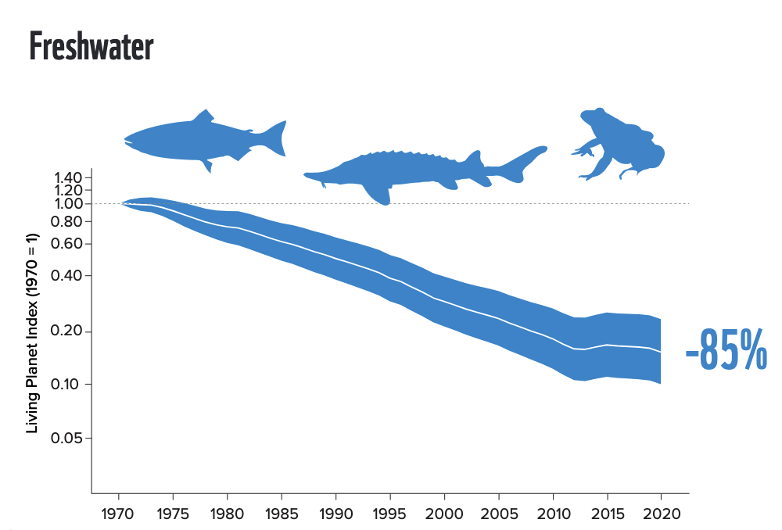
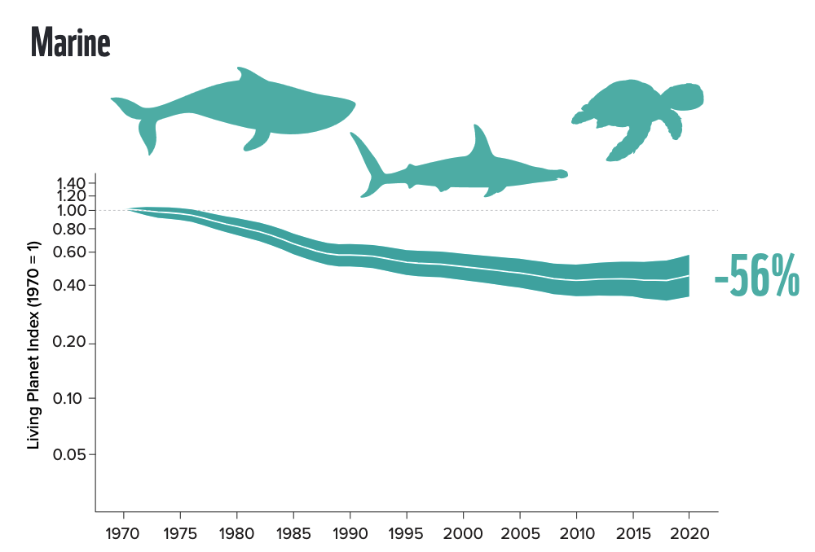
Living Planet Report, 2024
Notes:
https://wwflpr.awsassets.panda.org/downloads/2024-living-planet-report-a-system-in-peril.pdf

Slide 13
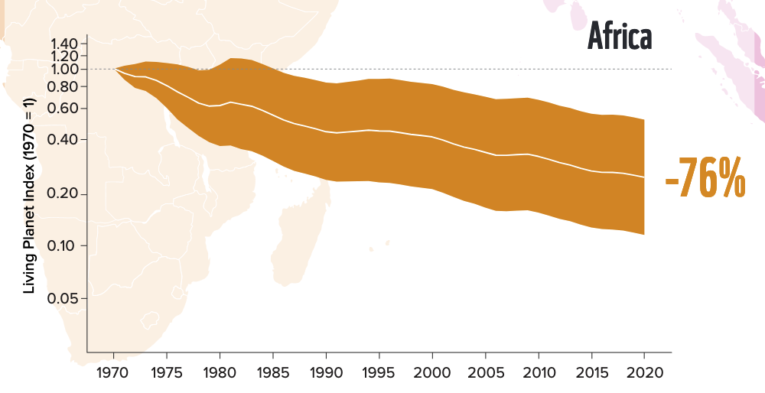
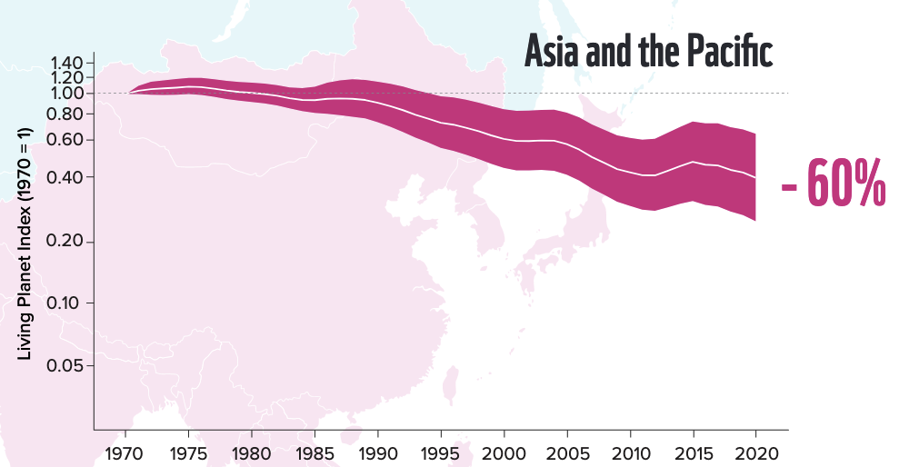
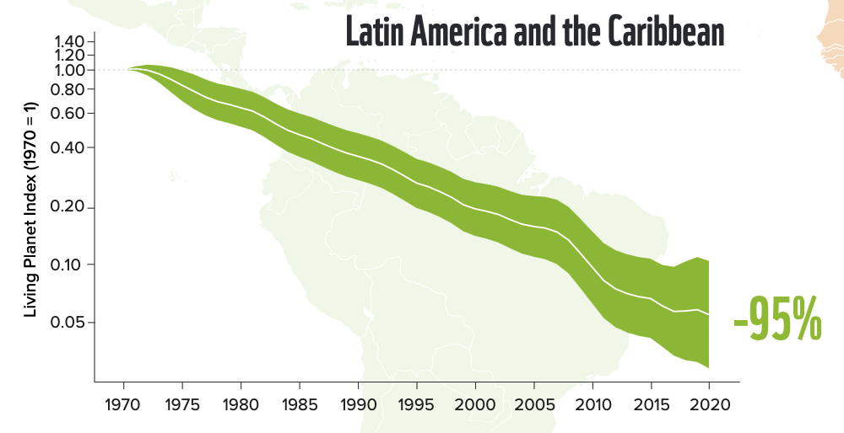
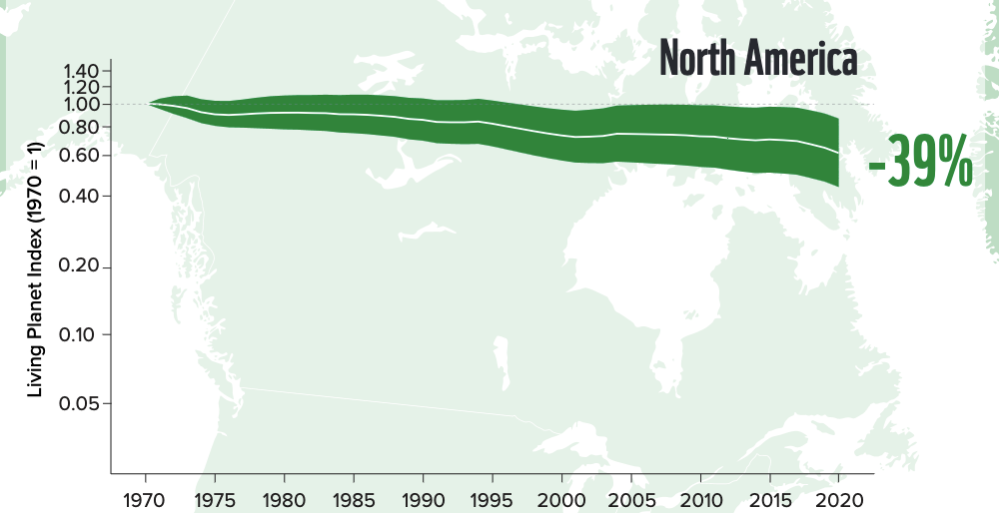
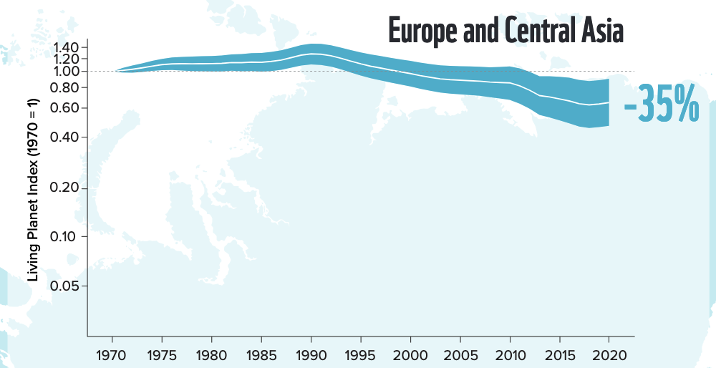

Slide 14
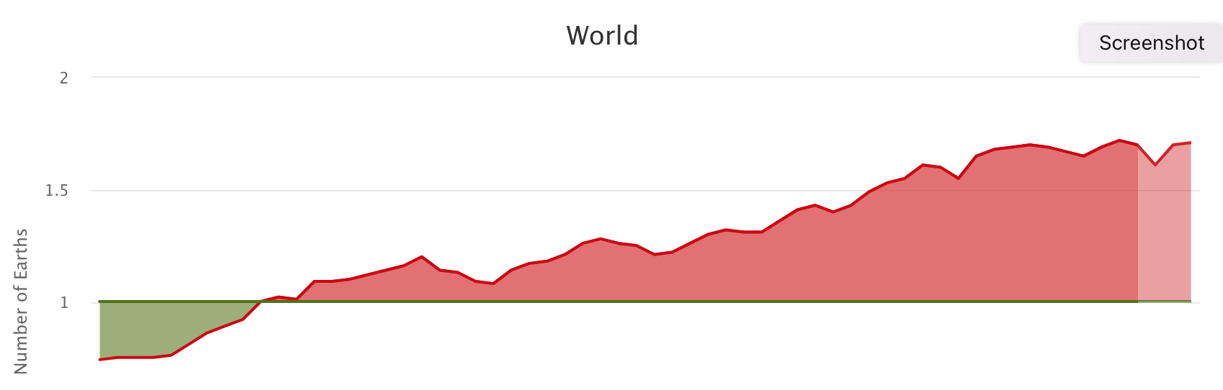
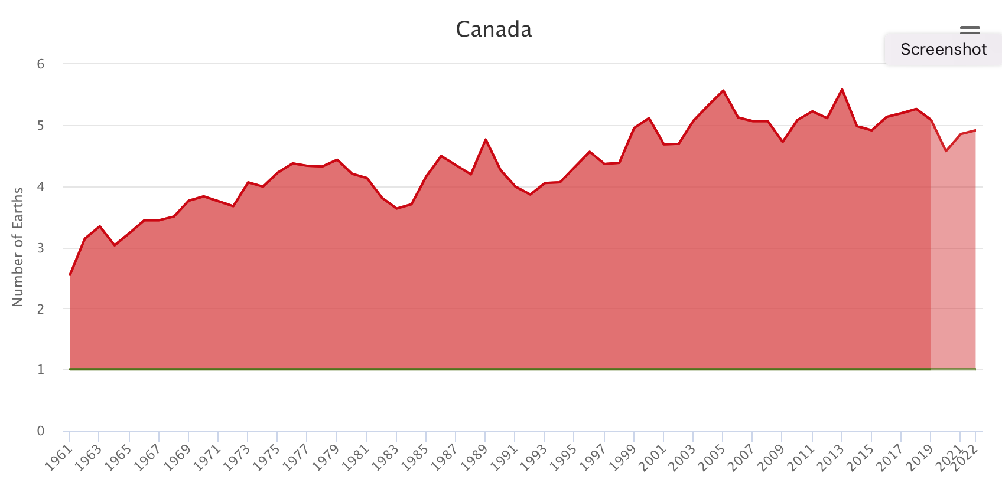
Ecological Footprint
1.71
1972
4.91
3.57
https://data.footprintnetwork.org/#/countryTrends?cn=5001&type=earth

Slide 15
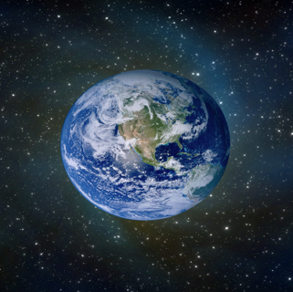
We behave in Canada as if we have all this . . .
5 planets
test
test
test
test

Slide 16
. . . but this is what we actually have

Slide 17
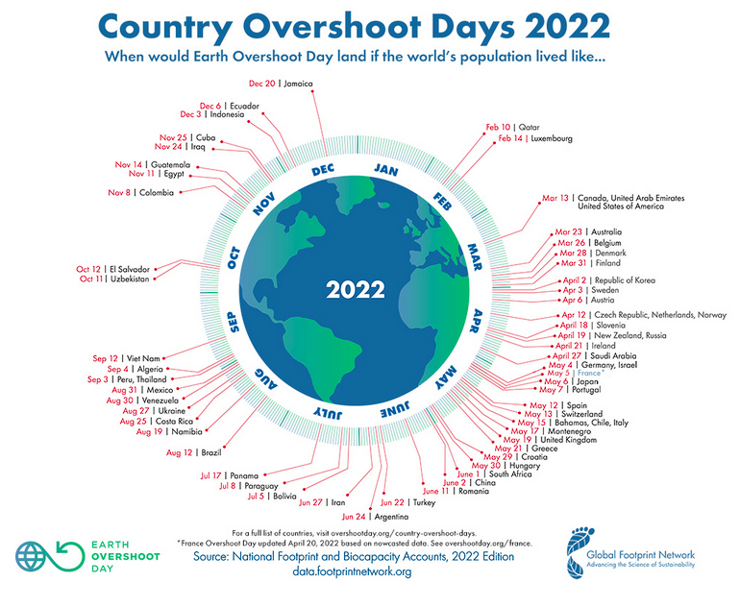
https://www.overshootday.org/newsroom/country-overshoot-days/
Notes:
https://www.overshootday.org/newsroom/country-overshoot-days/

Slide 18
All this is driven by three powerful forces . . .
Economic growth*
  Global GDP grew 14.5 x since 1950 (from 11.7 trillion in 1950 to well over $170 trillion in 2024)
  Global GDP per capita grew 4.6 x from $4,600 in 1950 to $21,268 in 2024
Population growth
  Global population grew 3.2 x since 1950 (from around 2.5 billion to 8 billion in 2023)
All enabled by the power of our technology
* expressed in international-$ in 2021 prices
Source: Our World in Data
Notes:
Source: Our World in Data, Oxford Martin School, University of Oxford
https://ourworldindata.org/grapher/global-gdp-over-the-long-run
https://ourworldindata.org/grapher/global-average-gdp-per-capita-over-the-long-run
https://ourworldindata.org/population-growth

Slide 19
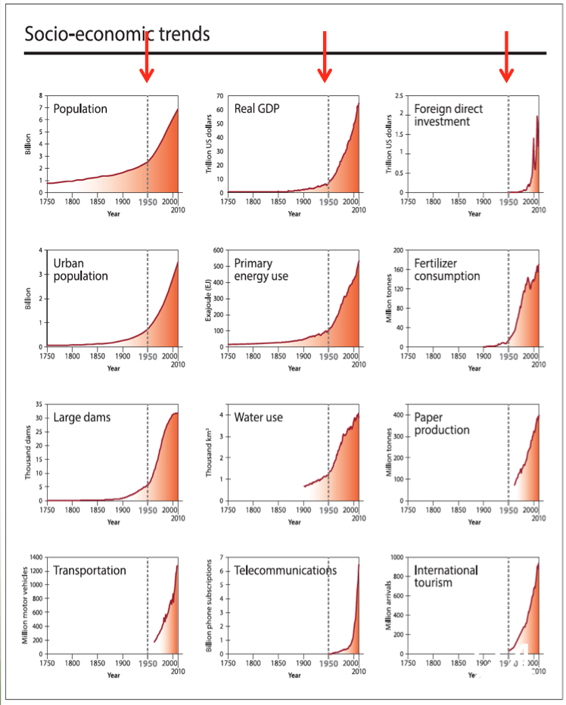
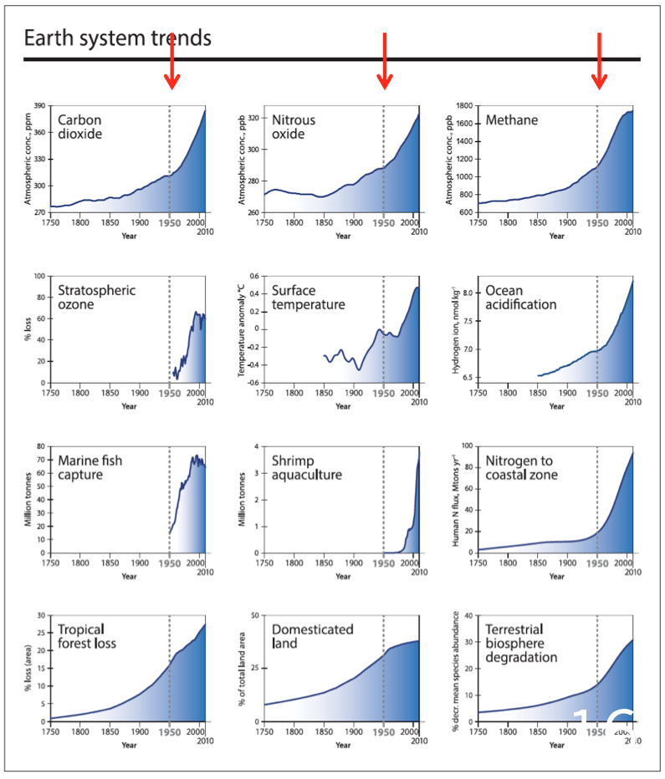
. . . .operating massively and rapidly
The Great Acceleration – Steffen et al. 2015
Notes:
Steffen, Will; Broadgate, Wendy; Deutsch, Lisa; Gaffney, Owen and Ludwig, Cornelia (2015) The trajectory of the Anthropocene: The Great Acceleration The Anthropocene Review 2(1) 81–98

Slide 20
1 a) The polycrisis

Slide 21
A confluence of challenges
“We have started 2023 staring down the barrel of a confluence of challenges unlike any other in our lifetimes. Wars grind on. The climate crisis burns on. Extreme wealth and extreme poverty rage on. The gulf between the haves and have-nots is cleaving societies, countries and our wider world. Epic geopolitical divisions are undermining global solidarity and trust.”
UN Secretary-General's briefing to the General Assembly on Priorities for 2023, 6 February 2023
And that was 2.5 years ago, since when its gotten worse!

Slide 22
The Anthropocene is just one part of the polycrisis
We face the following global systemic risks:
climate heating
biodiversity loss
pandemics
widening economic inequalities
financial system instability
ideological extremism
pernicious social impacts of digitalization
cyber attacks
mounting social and political unrest
large-scale forced migrations and
an escalating danger of nuclear war.”
Cascade Institute and Institute for
Advanced Sustainability Studies, July 2022
Notes:
Thomas Homer-Dixon, Ortwin Renn, Johan Rockström, Jonathan F. Donges, and Scott Janzwood (2022) A call for an international research program on the risk of a global polycrisis (Technical Paper #2022-3 Version 2.0, July 20. 2022) Victoria BC: Cascade Institute, Royal Roads University

Slide 23
A polycrisis is . . .
not just a set of isolated crises happening at the same time, but a set of interacting crises that are “producing far greater harm together than the sum of harms they’d produce in isolation”
These crises “simultaneously span natural, political, economic and technological systems, because they’re driven by a multiplicity of underlying ‘systemic risks’.”
Moreover, those crises “are not only worse than they were one or two decades ago, they’re also getting worse faster”
Homer-Dixon, Lawrence and Janzwood, Globe and Mail, 18 Feb 2023
Notes:
Dismissing the term ‘polycrisis’ has one inevitable consequence – reality always bites
Thomas Homer-Dixon, Michael Lawrence and Scott Janzwood
Contributed to The Globe and Mail
Published February 18, 2023

Slide 24
.
It is the both the scale and
the rapidity of change
that matters

Slide 25
Acceleration is itself accelerating
“The speed of change is staggering”,
“it has become clear that the world is facing a different context than it faced even ten years ago.”
This is due to
“the rapid rate of change combined with technological developments, more frequent and devastating disasters and an increasingly turbulent geopolitical landscape.”
Navigating New Horizons – UNEP, 2024
Notes:
UNEP (2024) Navigating New Horizons

Slide 26
“the state of the planet is broken. Humanity is waging war on nature.
This is suicidal.”
Antonio Guterres, UN Secretary General, at Columbia University’s World Leaders Forum, December 2nd 2020

Slide 27
Growing inequality
Income and wealth inequalities have been on the rise nearly everywhere since the 1980s, following a series of deregulation and liberalization programs which took different forms in different countries.
These differences . . . confirm that inequality is not inevitable, it is a political choice.
World Inequality Report 2022

Slide 28
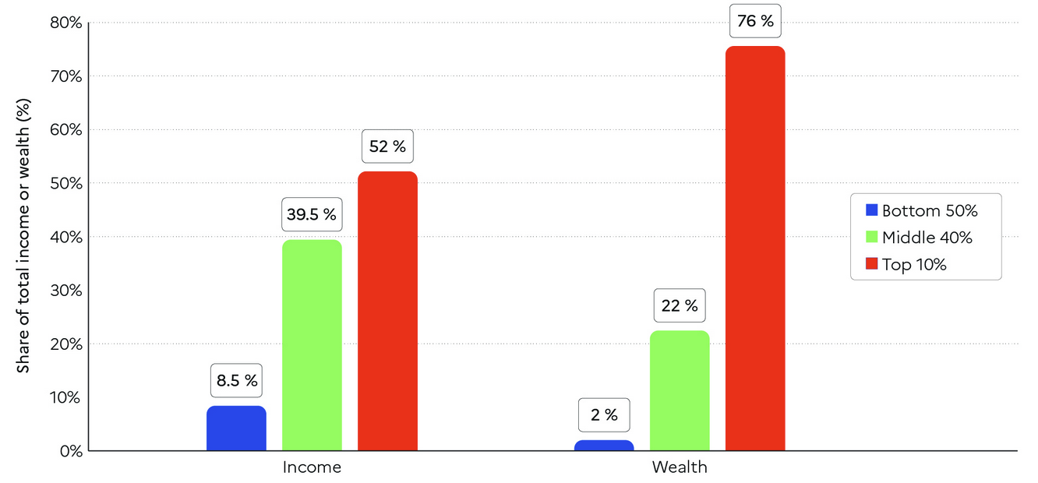
Global income and wealth inequality, 2021
World Inequality Report 2022
Notes:
https://wir2022.wid.world/executive-summary/

Slide 29
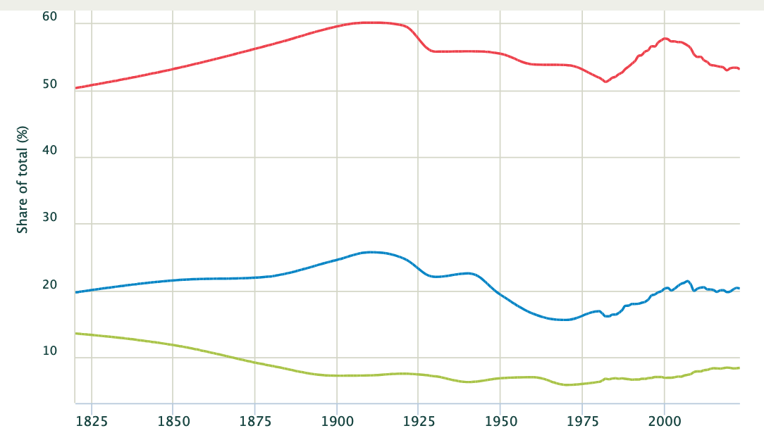
World income inequality
2023
Pre-tax national income - Top 10% share
53.1%
Pre-tax national income – Top 1% share
20.3%
Pre-tax national income – Bottom 50% share
8.4%
World Inequality Database
Notes:
https://wid.world/country/world/

Slide 30
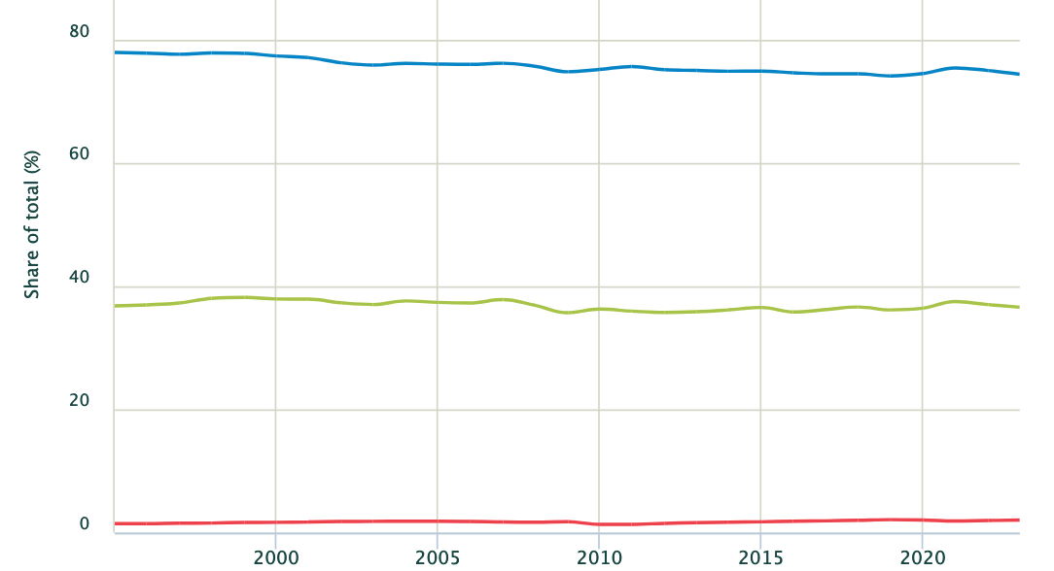
World wealth inequality
2023
Net personal wealth
Top 10% share
74.4%
Net personal wealth
Top 1% share
36.6%
Net personal wealth - Bottom 50% share
2%
World Inequality Database
Notes:
https://wid.world/country/world/

Slide 31
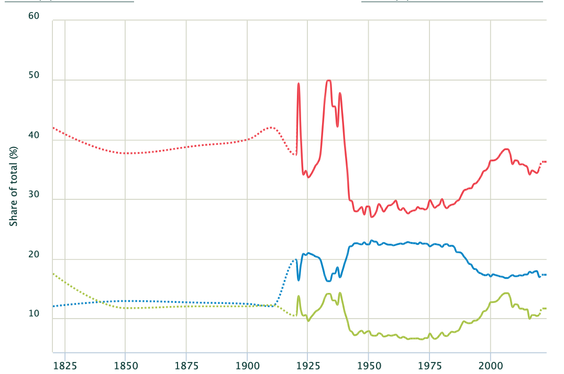
Canada pre-tax income inequality
Pre-tax national income - Top 10% share
2023
36.3%
Pre-tax national income – Bottom 50% share
17.3%
Pre-tax national income –
Top 1% share
11.6%
World Inequality Database
Notes:
https://wid.world/country/canada/

Slide 32
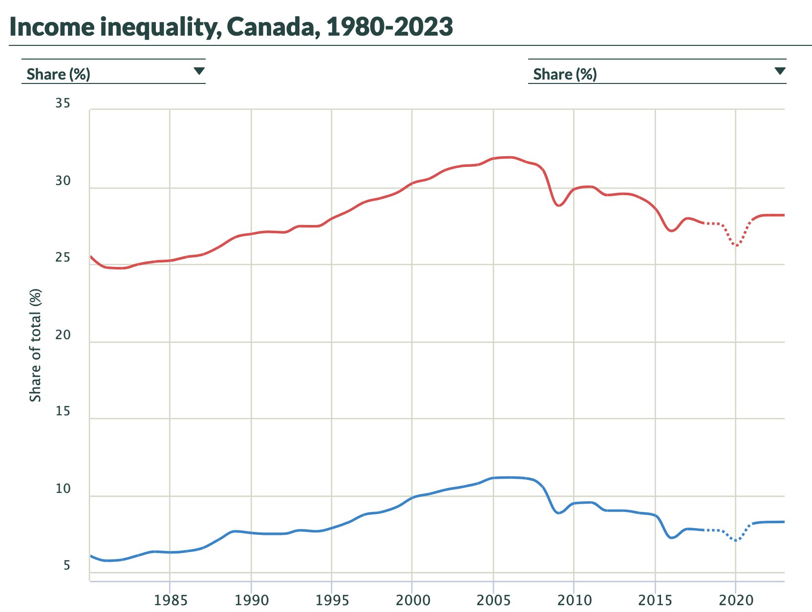
Canada post-tax income inequality
2023
Post-tax national income - Top 10% share
28.2%
Post-tax national income – Top 1% share
8.3%
World Inequality Database
Notes:
https://wid.world/country/canada/

Slide 33
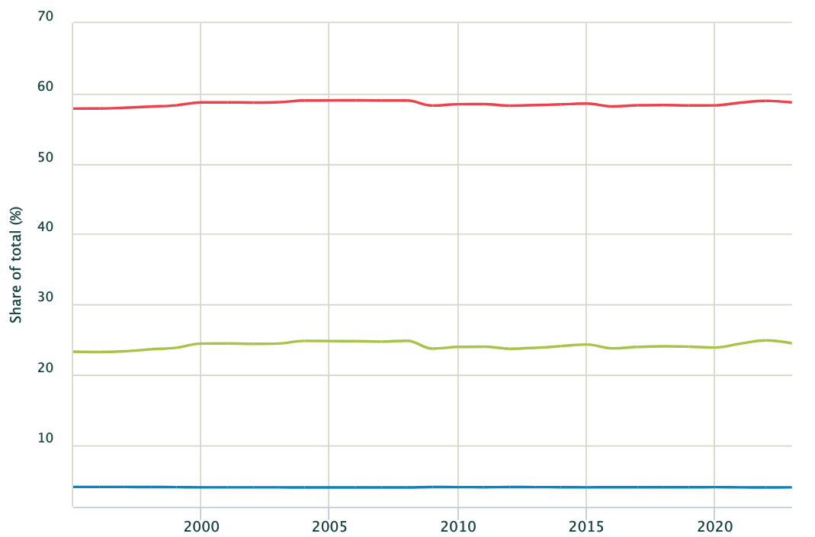
Canada wealth inequality
2023
Net personal wealth
Top 10% share
58.7%
Net personal wealth
Top 1% share
24.5%
Net personal wealth
Bottom 50% share
4.0%
World Inequality Database
Notes:
https://wid.world/country/canada/

Slide 34
World social conditions
“societies across the world are facing deep challenges.
Inequalities remain stubbornly high;
many people struggle to earn adequate incomes in precarious jobs, and insecurity is on the rise.
Frustration with the status quo is fuelling distrust and straining the very foundations of global solidarity.”
World Social Report 2025
Notes:
https://social.desa.un.org/issues/world-social-report

Slide 35
World social condition, 2025
Income and wealth inequality within countries are extremely high but are not rising everywhere. Inequality trends differ even among countries at similar levels of development: policies matter.
Employment insecurity and precariousness, along with the social and economic uncertainties they generate, are putting pressure on societies, affecting trust in institutions and polarizing political discourses.
World Social Report 2025

Slide 36
Social cohesion at risk: a trust deficit
The weakening of social cohesion undermines capacities for collective action, threatening social progress and the achievement of the SDGs.
Trust, a core dimension of social cohesion, is low and declining, both among people and toward institutions.
Over half of the global population has little or no trust in their government. Each consecutive cohort, from those born in the 1930s to those born in the 1990s, has been less trusting of government than the one before.
Less than 30 per cent of people believe others can be trusted.
World Social Report 2025

Slide 37
  2. We need to change:
  Towards a
  Wellbeing Society

Slide 38
“Every system is perfectly designed to get the results it gets”
(Institute for Healthcare Improvement)
Notes:
Like Magic? (“Every system is perfectly designed…”)
By IHI Multimedia Team | Friday, August 21, 2015
Earl Conway and Paul Batalden, IHI Senior Fellow and Founding Chair of the IHI Board of Directors, clarify the origins of the quotation, “Every system is perfectly designed to get the results it gets.”
https://www.ihi.org/communities/blogs/origin-of-every-system-is-perfectly-designed-quote

Slide 39
Our systems are designed for negative outcomes!
“For a long time, we believed that our systems just needed fixing, that they were broken or outdated. But we’ve come to realize something more unsettling.
These systems are not broken. Their negative outcomes are not bugs. They are features of the way they were designed. And they are producing exactly what they were incentivized to produce — environmental degradation, exclusion, concentration of wealth, and structural inequality”
Saul Klein, former Dean of Business at UVic, and Arti Freeman, president and CEO of Definity Foundation,
Times Colonist, 11 July 2025
Notes:
“Empathy is our only hope”
Saul Klein and Arti Freeman
Times Colonist, 11 Jul 2025
Klein is executive director of the Victoria Forum and Freeman is president and CEO of Definity Foundation

Slide 40
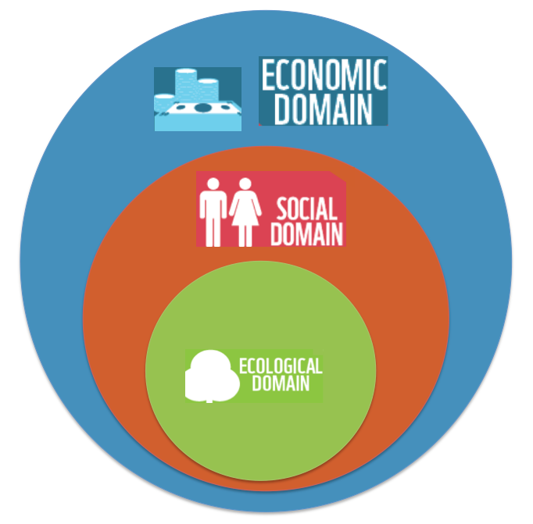
The way we seem to think it is

Slide 41
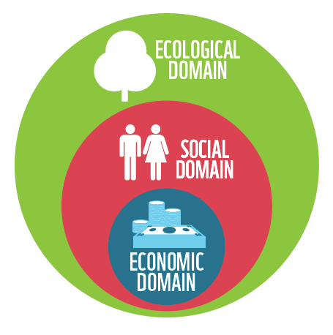
The way it is
WWF, 2014

Slide 42
“Ecosystems sustain societies that create economies.
It does not work the other way around.”
WWF, 2014

Slide 43
Wellbeing
Health is ”a state of complete physical, mental and social wellbeing” – WHO, 1948
“The presence of the highest possible quality of life in its full breadth of expression focused on but not necessarily exclusive to: good living standards, robust health, a sustainable environment, vital communities, an educated populace, balanced time use, high levels of democratic participation, and access to and participation in leisure and culture.”
Canadian Index of Wellbeing
Note that equity is missing from this definition

Slide 44
The Geneva Charter for Well-being
“expresses the urgency of creating sustainable well-being societies, committed to achieving equitable health now and for future generations without breaching ecological limits.”
WHO, 2022

Slide 45
Some key principles of a Wellbeing society
Make the wellbeing of all people, all living things, and the planet the central focus and purpose of society.
The wellbeing of all means this is about equity, including social and environmental justice.
This requires extending the principle of equity to future generations.
This must all be achieved within the Earth’s planetary boundaries.
This requires us to re-imagine a system and process of governance that is consistent with these intents.
Hancock and McLaren, PAHBC Summer Institute Think Piece, June 2025

Slide 46
Beyond reform
Reform involves changing the existing system, improving its form or condition without really changing the underlying system.
Transformation is about transforming the basic composition, structure, character or condition of that system.
Revolutionary change means changing the paradigm and radically and completely changing the system in fundamental ways.
Based on Merriam Webster Dictionary
Notes:
Definition & Meaning - Merriam-Webster
Reform
a : to put or change into an improved form or condition
b : to amend or improve by change of form or removal of faults or abuses
Transform
a: "to change in composition or structure
b: to change the outward form or appearance of
c: to change in character or condition
Revolution
a: a sudden, radical, or complete change
b: a fundamental change in political organization
c: activity or movement designed to effect fundamental changes in the socioeconomic situation
d: a fundamental change in the way of thinking about or visualizing something : a change of paradigm

Slide 47
Transformation is more than transition
Transformations are more profound and comprehensive processes of change than transitions.
Transitions tend to focus on reducing direct pressures on the environment in key sectors (e.g., energy, food) - and on incremental change.
Transformations . . . involve systemic, synergistic, structural, political, practical, and individual changes across scales to address fundamental drivers of Earth-system change in behaviour, technologies, and policy.
Gupta et al, 2024 - A just world on a safe planet:
a Lancet Planetary Health–Earth Commission report
Notes:
Gupta, J et al., (2024) A just world on a safe planet: a Lancet Planetary Health–Earth Commission report on Earth-system boundaries, translations, and transformations Lancet Planet Health
Published Online September 11, 2024 https://doi.org/10.1016/ S2542-5196(24)00042-1
https://www.thelancet.com/journals/lanplh/article/PIIS2542-5196(24)00042-1/fulltext

Slide 48
Some approaches to consider
Legal and ethical approaches: The rights of future generations and nature
Broadening concepts of social justice
Re-discovering the spirit in nature
An economics fit for purpose in the Anthropocene
Culture wars: Ideology, interest and ‘ignore-ance’
Changing social norms and core values
One Planet politics

Slide 49
i) Legal and ethical approaches
The right to a healthy environment
  Recognised by the UNHRC
Inter-generational rights - The right of future generations to a healthy environment
  The Welsh Well-Being of Future Generations Act (2015) and the Future Generations Commissioner for Wales

Slide 50
Inter-species rights - the right of other species and indeed entire ecosystems to exist
Personhood for nature
  New Zealand has granted legal recognition as persons to both the Whanganui river and the Te Urewera region – previously a national park
  See Pachamama in Ecuador and elsewhere
  See proposal from BC Assembly of First Nations and others
Create the offence of ecocide - an ‘environmental crime against humanity’.

Slide 51
ii) Broadening concepts of social justice
Much the same as above. Social justice for
People where we live/in our country
People elsewhere in the world
Future generations
  We do not inherit the Earth from our parents, we borrow it from our children.
  Our role is to be good ancestors
Other species
  All our relations

Slide 52
iii) Re-discovering the spirit in nature
Biophilia - we have an innate need for nature (E.O Wilson)
  Outdoor play, nature kindergartens and ‘forest bathing’
Solastalgia - the impact of a loss of one’s environment on mental, emotional and physical wellbeing
  Does it play a role in the diseases of despair?

Slide 53
Reverence for Nature
We need to re-establish a reverence for nature
  Role of faith communities, spirituality etc?
“Within Indigenous worldviews our relationship with the natural world is characterised by reverence and values that include sustainability, guardianship and love.”
  Waiora – Indigenous Peoples’ Statement for Planetary Health and Sustainable Development, IUHPE 2019, Rotorua, Aotearoa New Zealand

Slide 54
iv) An economics fit for purpose
What sort of economy can meet the goal of achieving good health and a good quality of life for everyone, while living within the biophysical and ecological constraints of this one small planet that is our home?

Slide 55
Economy or society?
Economy
The wealth and resources of a country or region, especially in terms of the production and consumption of goods and services.
Society
The aggregate of people living together in a more or less ordered community

Slide 56
A wellbeing economy is not the end, it is the means: The end is a wellbeing society.

Slide 57
The problem is capitalism
“. . . we need to find means of generating human wellbeing that are better and less damaging than capitalism.”
“Our choice comes down to this. Do we stop life to allow capitalism to continue, or stop capitalism to allow life to continue?”
George Monbiot, The Guardian, 25th April 2019

Slide 58
Different forms of capitalism
Free enterprise capitalism
Market capitalism
Plutocratic capitalism
Autocratic/Dictator capitalism
Suicidal capitalism
“We are waging war on nature. This is suicidal”
Antonio Guterres, UN Secretary General
2020

Slide 59
Real capitalism
There are four forms of capital:
  Natural
  Social
  Human
  Economic (tangible andf non-tangible)
Current capitalism largely ignores the first three
Real capitalism builds all four forms of capital at the same time

Slide 60
Some alternatives
Ecological/green economics
Steady state economics
Donut economics
De-growth

Slide 61
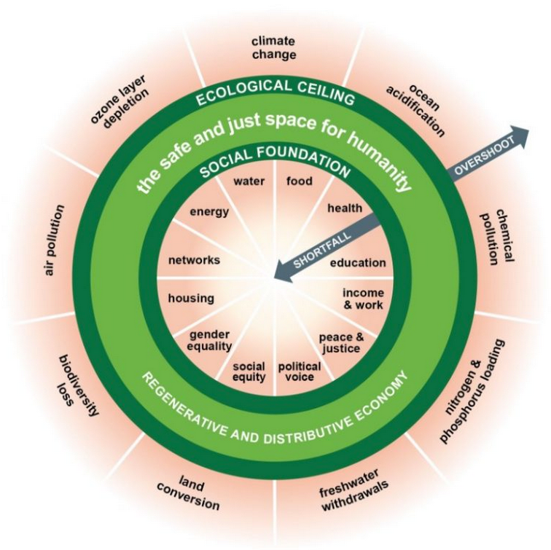
Doughnut economics: “Thriving in balance”
“a social foundation of well-being that no one should fall below and an ecological ceiling of planetary pressure that we should not go beyond. Between the two lies a safe and just space for all”
Kate Raworth,
Doughnut Economics

Slide 62
Purpose-driven organisations (PDOs)
ISO 37000 – “the tool to align all organizations world-wide to fulfil their meaningful purpose through engagement with their stakeholders and contribute to a sustainable world which respects the needs of future generations.”
ISO 37000:2021 Governance of organizations
“A PDO is an organization that exists to contribute to a sustainable future and does this through innovating, managing and caring properly for its systems, resources and stakeholders, while ensuring enough profit.”
British Standards Institute - PAS 808:2022
Notes:
https://committee.iso.org/files/live/sites/tc309/files/ISO%2037000%20slides/ISO%2037000%20Governance%20of%20organizations%20-%20Guidance%20-%20v1%202022%20web.pdf
Download PAS 808:2022 and a full range of other standards now
at: https://knowledge.bsigroup.com/products/purpose-driven-organizations-worldviews-principles-and-behaviours-for-delivering-sustainability-guide

Slide 63
ISO 37000
“the first ever international benchmark for good governance”
Applies to all organisations – public, private and non-profit – and at all scales from the local to the global.
It states: “Purpose and sustainability are now at the heart of governance” and that the standard is intended to ensure that “organizations act with purpose, sustainability and society in mind”
https://committee.iso.org/ISO_37000_Governance

Slide 64
v) Culture wars:
Ideology, interest and ‘ignore-ance’
We “develop worldviews that are consistent with the values held by others within the groups with which we self-identify”
We “gravitate towards opinions that fit with those of the people with whom we identify”
As a result, “our cognitive filters reflect our cultural identity” and our “cultural identity can overpower scientific reasoning”, leading us to ignore information that does not fit with our ideological views and cultural identity.
Andrew Hoffman, Holcim Professor of Sustainable Enterprise
School of Business, University of Michigan,
In his 2018 book ‘How culture shapes the climate debate’

Slide 65
Ignorance – or ‘ignore-ance’?
‘Ignore-ance’ is "an active dynamic of negation, an active refusal of information”
Ellsworth (1997)

Slide 66
vi) Changing social norms and core values
A social norm is “a shared expectation of behaviour that is considered culturally desirable and/or appropriate”.
While not a rule or regulation per se, “people come to act in conformity with the norms of their society”
Scott, 2014
Notes:
Scott, John (2014) A Dictionary of Sociology (4 ed.) Oxford: Oxford University Press

Slide 67
Values shift
Jeremy Lent, in his 2017 book The Patterning Instinct, discusses “the great transition” and that this “will only take place if enough people are conscious of its need and prepared to change their own values and behaviour to affect humanity’s direction”.
Notes:
Lent, Jeremy (2017) The Patterning Instinct: A Cultural History of Humanity’s Search for Meaning Amherst, NY: Prometheus

Slide 68
Core values to shift
Lent sees three core values that would emerge from this new worldview as foundational principles for our major decisions. They are:
an emphasis on quality of life,
a sense of shared humanity and
environmental sustainability
Jeremy Lent, The Patterning Instinct, 2017

Slide 69
The Great Transition Initiative
Focused on a deep transformation of culture and society, away from “the conventional triad of individualism, consumerism, and domination of nature” that lies at the root of our current global and local crises.
We need to develop “a constellation of values - human solidarity, quality of life, and ecological sensibility” that will get us to the future we need.
What is the Great Transition?https://greattransition.org/about/what-is-the-great-transition
Notes:
https://greattransition.org/
What is the Great Transition?
https://greattransition.org/about/what-is-the-great-transition

Slide 70
Four value sets that need transforming
First value set: The Earth
Reverence for the Earth and all it contains, an awareness of a connection to nature that is, at its heart, spiritual.
Second value set: Society
Solidarity - a re-awakening of our sense of kinship with and shared responsibility for our fellow humans, a sense of community
Notes:
Earth Day and a Values Revolution
A Homily for the First Unitarian Church of Victoria
Dr. Trevor Hancock
21 April 2024

Slide 71
Third value set: Economy
Must be
a) consistent with the reality of the finite and limited Earth on which we live, and
b) in service to society, and to creating the conditions that enable wellbeing for all, both now and for future generations.
Fourth value set: Priorities
We have to live with an understanding that “Ecosystems sustain societies that create economies. It does not work the other way around”
Trevor Hancock, April 2024
Notes:
Earth Day and a Values Revolution
A Homily for the First Unitarian Church of Victoria
Dr. Trevor Hancock
21 April 2024

Slide 72
Adopting Indigenous worldviews
Core features of Indigenous worldviews
“the interactive relationship between spiritual and material realms, inter-generational and collective orientations, that Mother Earth is a living being”
“locates humanity as part of Mother Earth’s ecosystems alongside our relations in the natural world.”
Waiora – Indigenous Peoples’ Statement for
Planetary Health and Sustainable Development
23rd IUHPE World Conference on Health Promotion
Rotorua, Aotearoa New Zealand, April 2019

Slide 73
Reverence for Nature
We need to re-establish a reverence for nature
  Role of faith communities, spirituality etc?
“Within Indigenous worldviews our relationship with the natural world is characterised by reverence and values that include sustainability, guardianship and love.”
  Waiora – Indigenous Peoples’ Statement for Planetary Health and Sustainable Development, IUHPE 2019, Rotorua, Aotearoa New Zealand

Slide 74
Personhood for nature in BC
“The BCAFN Chiefs-in-Assembly call on the Regional Chief to provide political advocacy . . . to support the advancement of the legal recognition of the rights of and personhood of nature, including water bodies such as rivers and lakes, forests and mountains within a First Nations’ unceded traditional territory”
BCAFN Annual General Meeting
October 8, 9 & 10, 2024

Slide 75
Numerous recent UN reports and other statements recognise the importance of Indigenous Peoples

Slide 76
It is time to heed Indigenous voices
“With indigenous peoples living on land that is among the most vulnerable to climate change and environmental degradation, it is time to heed their voices, reward their knowledge and respect their rights.”
Antonio Guterres, UN Secretary General, 2020
Notes:
Guterres, Antonio The State of the Planet (UN Secretary-General's address at Columbia University, 2 December 2020) https://www.un.org/sg/en/content/sg/statement/2020-12-02/secretary-generals-address-columbia-university-the-state-of-the-planet-scroll-down-for-language-versions

Slide 77
3. Implications for urban development
  Healthy communities
  One Planet communities
  Planetary Health cities
  Ecological impacts of different urban forms
  Livable Victoria

Slide 78
3 a) Healthy communities

Slide 79
Definition
“A healthy city is one that is continually creating and improving those physical and social environments and expanding those community resources which enable people to mutually support each other in performing all the functions of life and in developing to their maximum potential.”
Hancock & Duhl, 1986

Slide 80
11 parameters of a Healthy City/Town
1. A clean,safe,high quality physical environment (including housing quality).
2. An ecosystem which is stable now and sustainable in the long term.
3. A strong, mutually-supportive and non-exploitative community.

Slide 81
4. A high degree of public participation in and control over the decisions affecting one's life, health and well-being.
5. The meeting of basic needs (food,water, shelter, income, safety, work) for all the City's people.
6. Access to a wide variety of experiences and resources with the possibility of multiple contacts, interaction and communication.

Slide 82
7. A diverse, vital and innovative city economy.
8. Encouragement of connectedness with the past, with the cultural and biological heritage and with other groups and individuals.
9. A city form that is compatible with and enhances the above parameters and behaviours.

Slide 83
10. An optimum level of appropriate public health and sick care services accessible to all.
11. High health status (both high positive health status and low disease status).
Hancock and Duhl, 1986

Slide 84
3 b) One Planet Communities

Slide 85
This is what
it’s all about

Slide 86

But in Canada we behave as if we have all this
5.1 planets
test
test
test
test
Global Footprint Network (2022) National Footprint and Biocapacity Accounts, 2022 Edition (Data Year 2018)
Notes:
Global Footprint Network (2022) National Footprint and Biocapacity Accounts, 2022 Edition (Data Year 2018)
© 2022, Global Footprint Network, York University, National Footprint and Biocapacity Accounts, 2022 Edition. For more information, contact data@footprintnetwork.org

Slide 87
Recognise that getting to a ‘One Planet’ Canada
– our fair share - requires an 80% reduction in Canada’s ecological footprint (2/3 of which is carbon) . . .
. . . while at the same time meeting basic needs and ensuring high levels of human and social development and good health for all

Slide 88
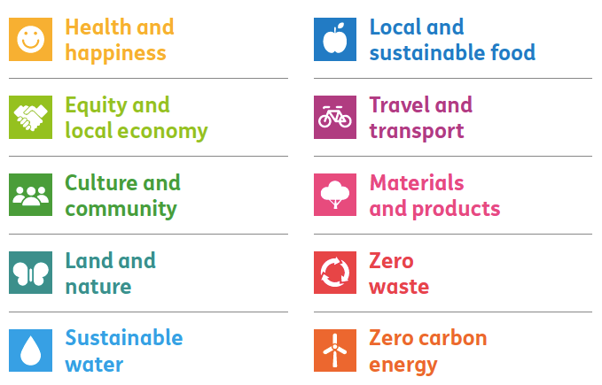
Bioregional’s 10 principles of One Planet Living
Bioregional Annual Review, 2015 -16

Slide 89
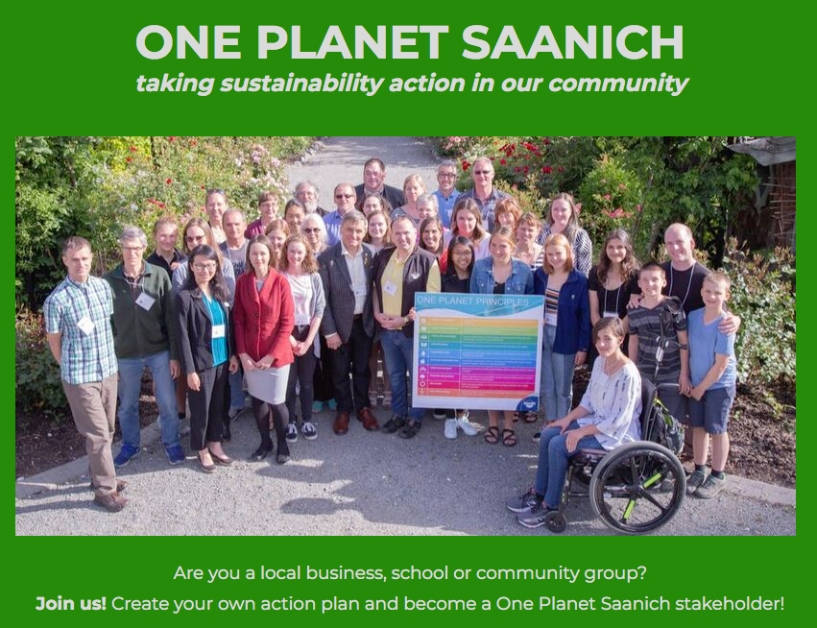

Slide 90
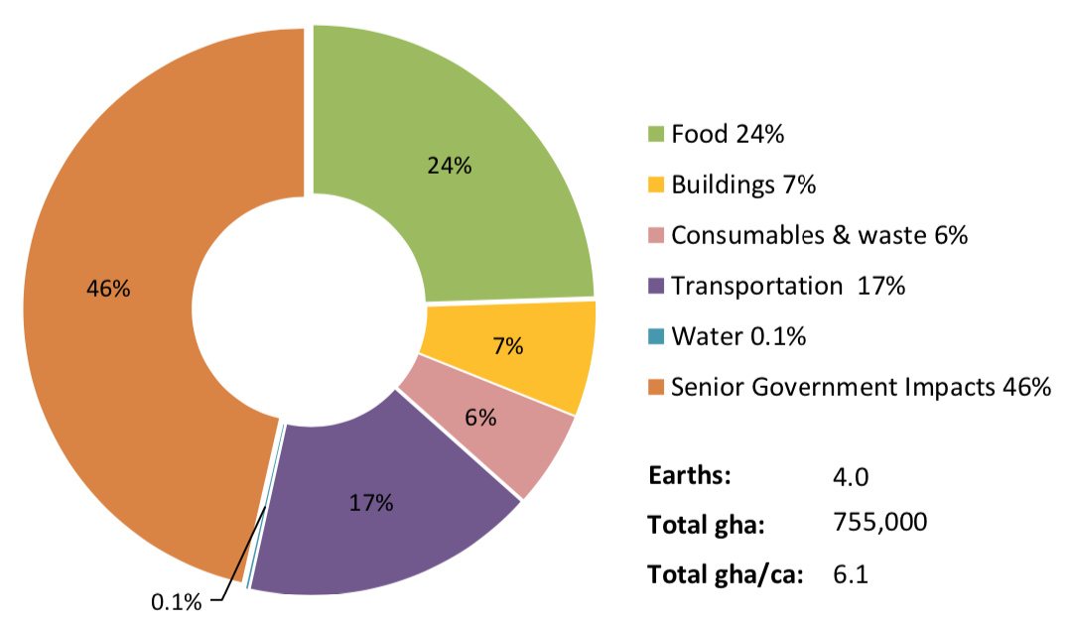
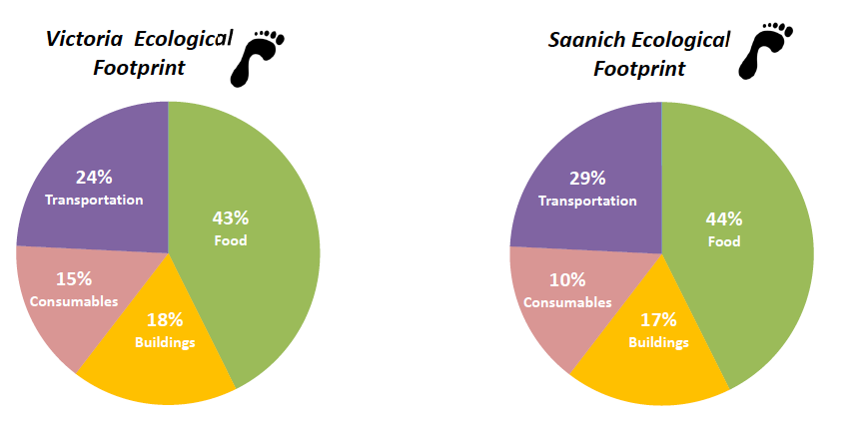
2021 Saanich ecological footprint = 4 planets
Source: CHRM Consulting, 2018
Notes:
Source: ecoCity Footprint Tool
Victoria & Saanich Pilot Testing Results
One Planet Conversations
April 12th, 2018
Presented by:
Dr. Jennie Moore
Cora Hallsworth

Slide 91
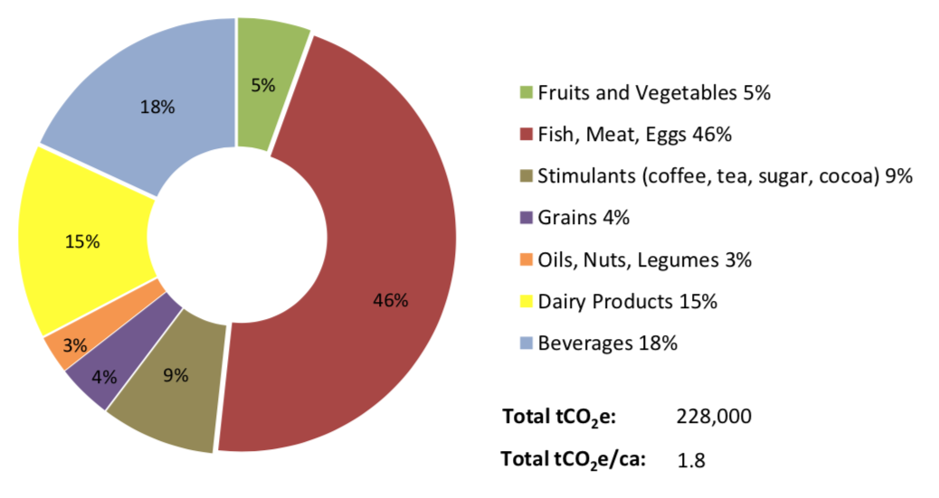
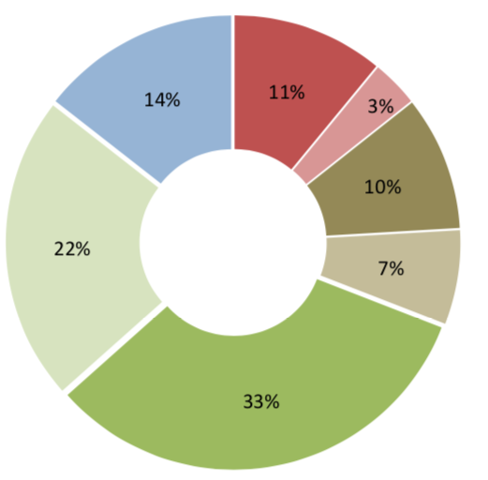
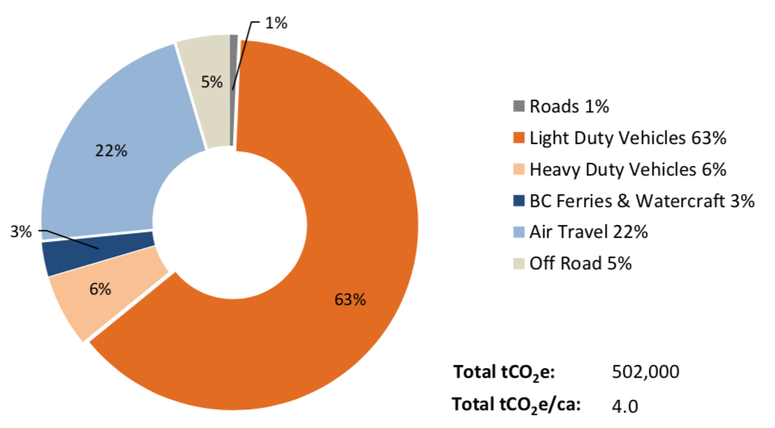
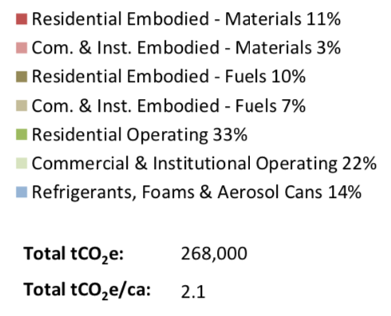
FOOD
24%
7%
BUILDINGS
TRANSPORT
17%

Slide 92
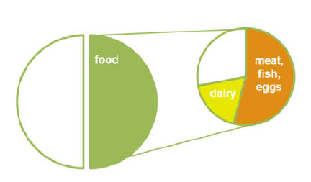
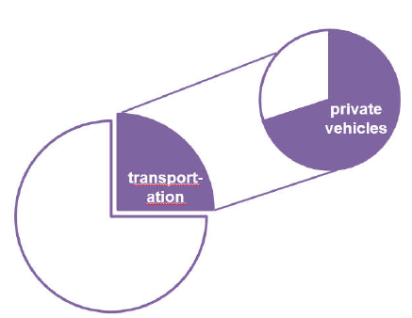
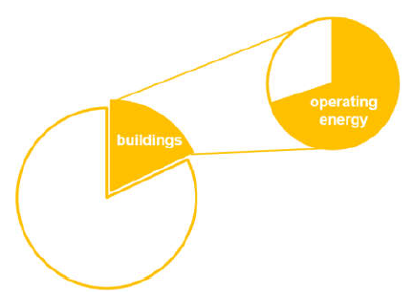
Saanich’s ecological footprint
Source: One Planet Saanich Team, 2018
Notes:
DRAFT
District of Saanich
One Planet Gap Analysis
[SEPT 18, 2018]

Slide 93
Happily, there are many health co-benefits . . .

Slide 94
Health co-benefits of a One Planet region
Clean energy systems (industry, transportation, electricity generation, space heating etc)
  Reduced climate change, reduced air pollution
Low meat diet, smaller portions
  Reduced mortality, reduced obesity
Active and public transportation
  Fewer injuries, increased physical activity, strengthened social connections
Reduced pollution and waste
Other?

Slide 95
Feeding a One Planet Region
Source: One Planet Saanich Team, 2018
Notes:
DRAFT
District of Saanich
One Planet Gap Analysis
[SEPT 18, 2018]

Slide 96
“Eat food, not too much, mostly plants”
(Michael Pollan, In Defense of Food) would be a good national food policy
Notes:
McEvoy CT, Temple N. and Woodside JV (2012) Vegetarian diets, low-meat diets and health: a review Public Health Nutr. 15(12): 2287-94

Slide 97

The EAT-Lancet Commission
“global consumption of fruits, vegetables, nuts and legumes will have to double, and consumption of foods such as red meat and sugar will have to be reduced by more than 50 percent”.
“a diet rich in plant-based foods and with fewer animal source foods confers both improved health and environmental benefits”

Slide 98
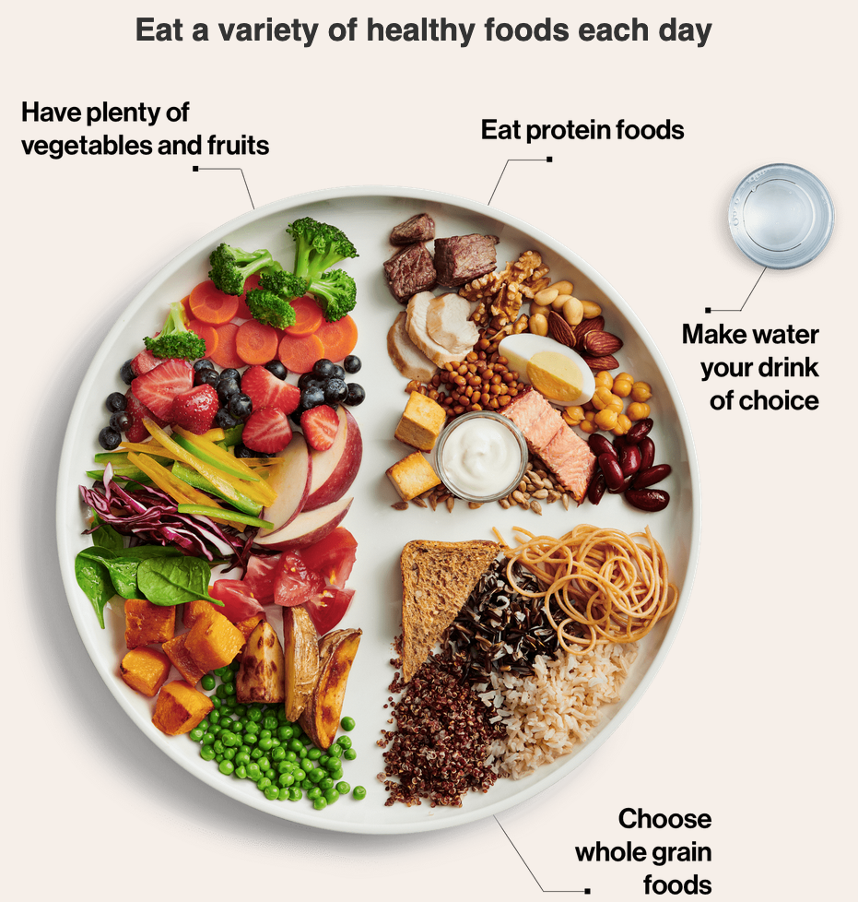
The new Canada Food Guide (2019)

Slide 99
Co-benefits of active/ public transportation
Reduced GHGs
Reduced air pollution
Fewer injuries
Increased physical activity
Strengthens social connections

Slide 100
Health benefits of conservation and clean energy
Reduced GHGs
Reduced air pollution
Local energy democracy
Increased local jobs (skilled labour)

Slide 101
One Planet Saanich and One Planet BC
One Planet Living is our vision for happier, healthier lives for everyone within the limits of our one planet. We help communities across the province understand sustainability priorities – and take action!
  https://oneplanetbc.com/
Initiated in 2018 as part of a global project, One Planet Saanich engages schools, businesses and community groups to create their own One Planet Action Plans.
  https://oneplanetbc.com/one-planet-saanich/
Centre for Ecocities, BCIT
The world’s first Centre for Ecocities supports the evolution of ecocities worldwide.
  https://www.bcit.ca/centre-for-ecocities/

Slide 102
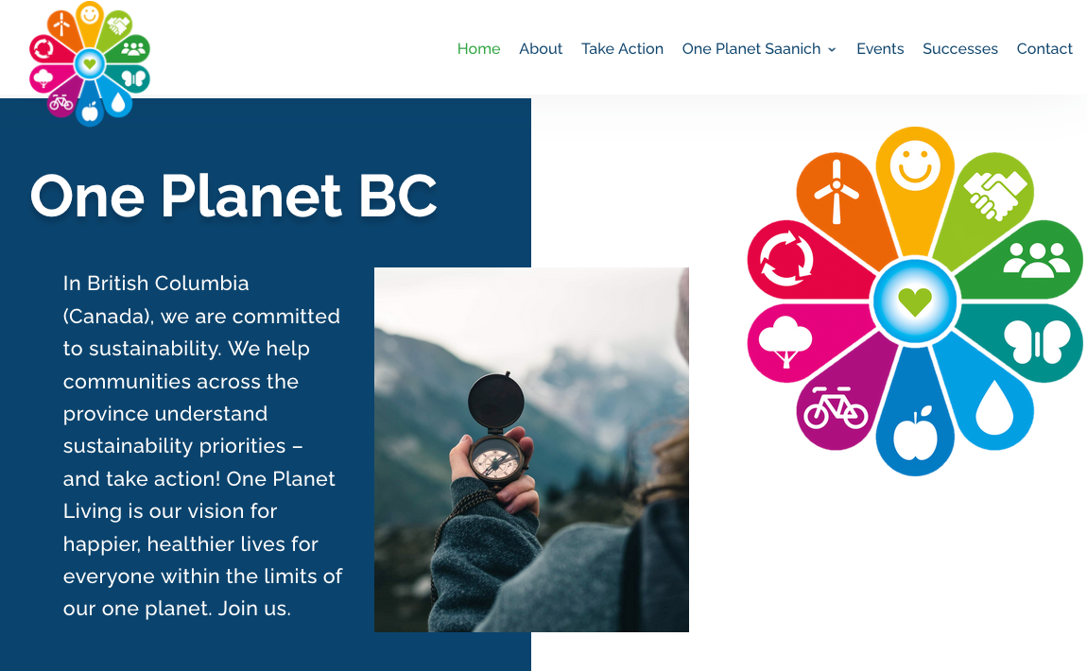
One Planet BC
https://oneplanetbc.com/

Slide 103
3 c) Planetary Health Cities

Slide 104
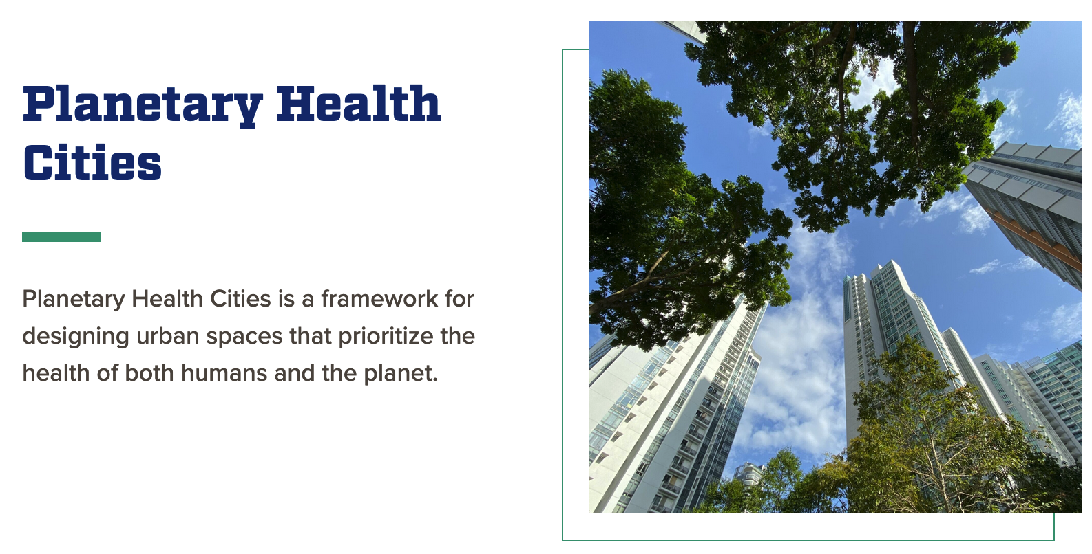
https://planetaryhealth.jhu.edu/programs-2/practice/planetary-health-cities/

Slide 105
3 d) Ecological impacts of different urban forms

Slide 106
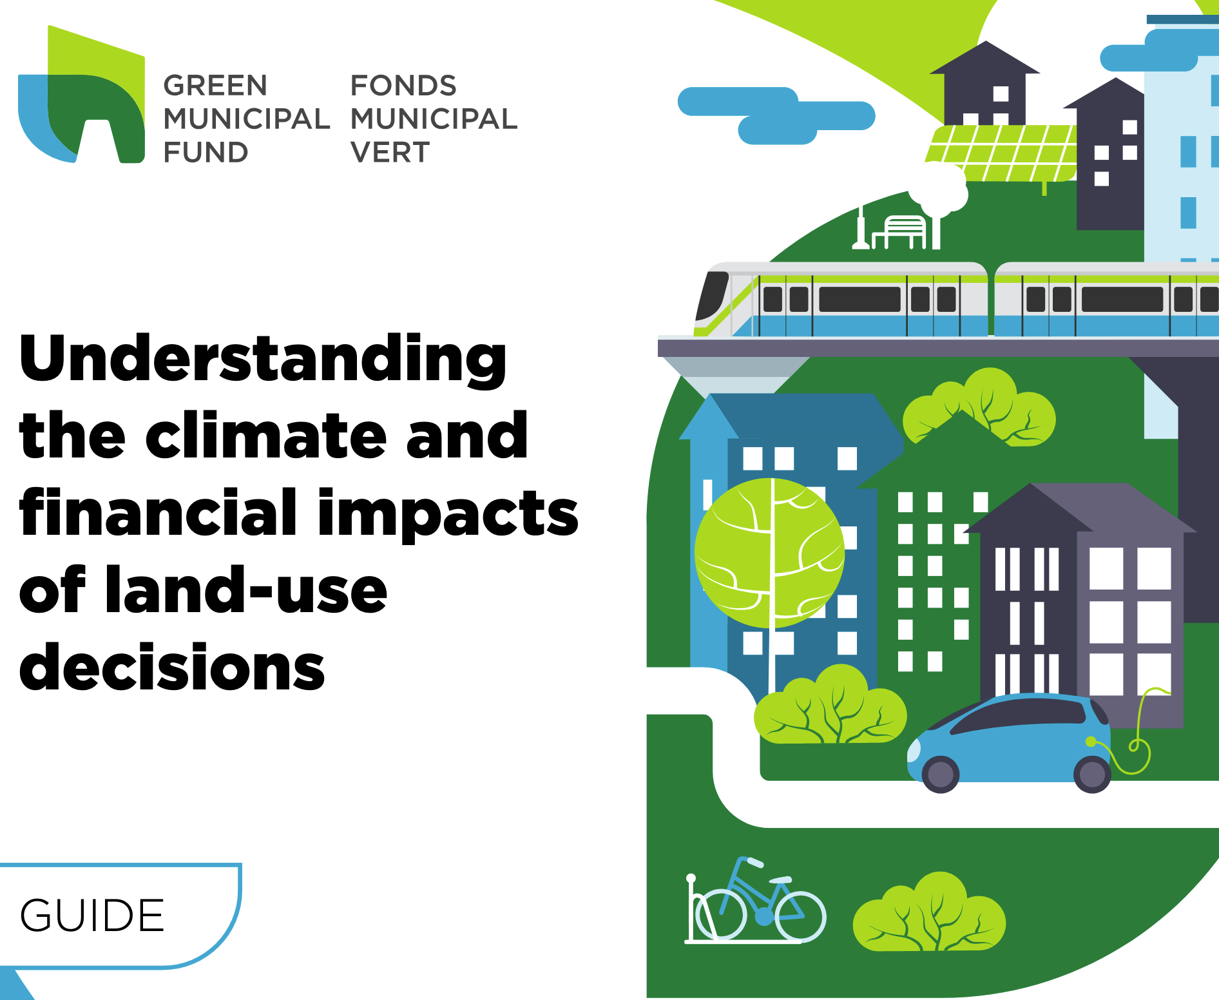

Slide 107
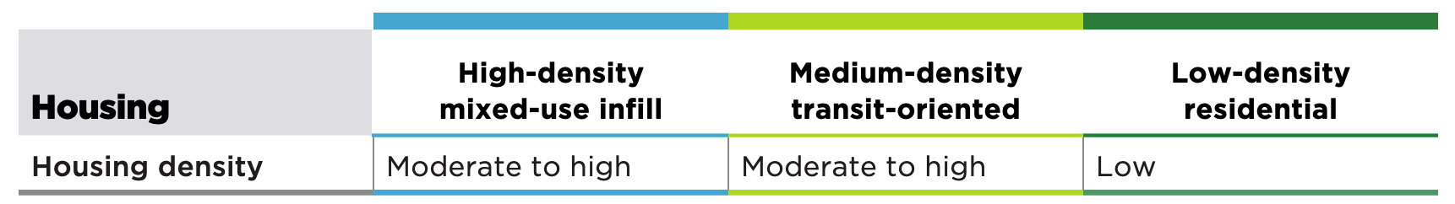
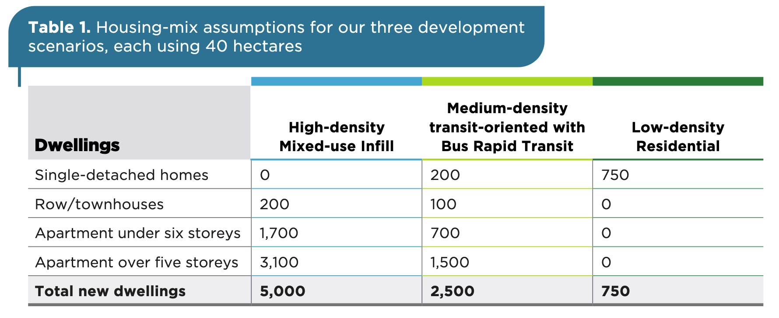
Housing-mix assumptions for three development scenarios, each using 40 hectares
Notes:
Understanding the climate and financial impacts of land-use decisions – Federation of Canadian Municipalities, 2024
https://media.fcm.ca/sites/GMF/resources/Toolkit/understanding-the-climate-and-financial-impacts-of-land-use-decisions.pdf

Slide 108
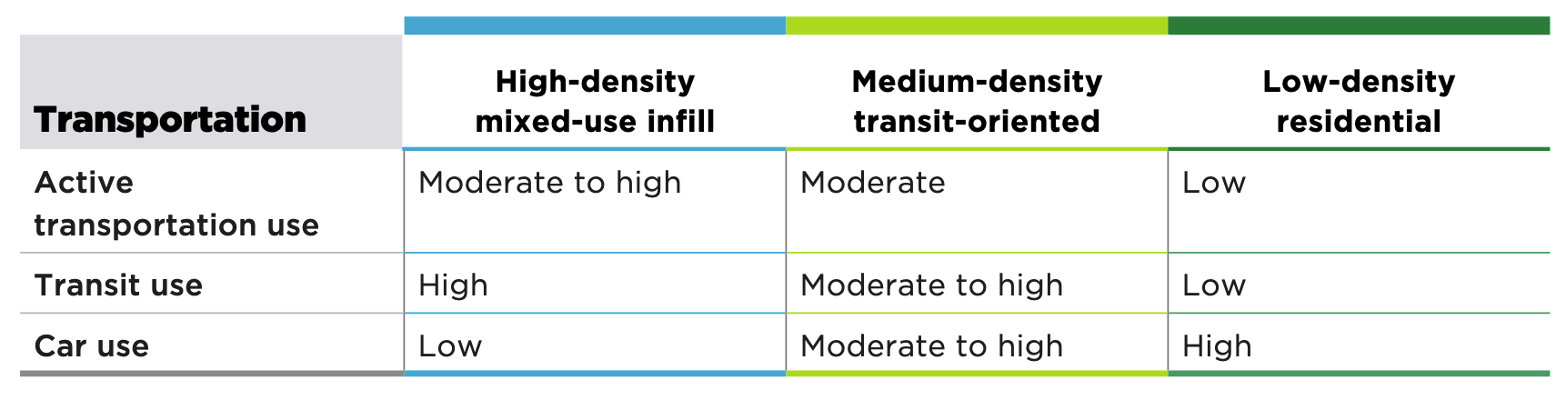
Notes:
Understanding the climate and financial impacts of land-use decisions – Federation of Canadian Municipalities, 2024
https://media.fcm.ca/sites/GMF/resources/Toolkit/understanding-the-climate-and-financial-impacts-of-land-use-decisions.pdf

Slide 109
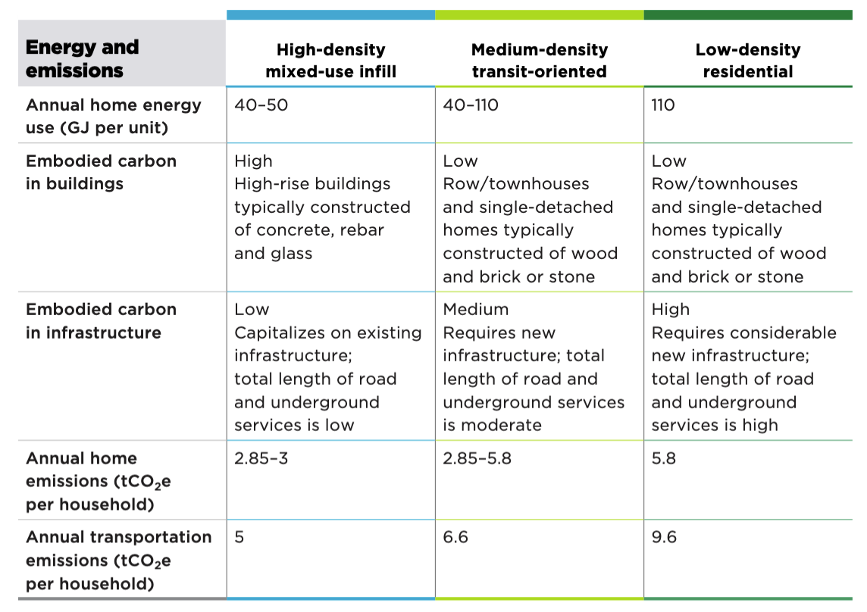
Notes:
Understanding the climate and financial impacts of land-use decisions – Federation of Canadian Municipalities, 2024
https://media.fcm.ca/sites/GMF/resources/Toolkit/understanding-the-climate-and-financial-impacts-of-land-use-decisions.pdf

Slide 110
Emissions in summary
 | Annual home energy use (GJ per unit) | Embodied carbon in buildings | Embodied carbon in infrastructure | Annual home emissions (tCO2e per household) | Annual transport emissions (tCO2e per household)
High-density mixed-use infill | 40 - 50 | High | Low | 2.85 - 3 | 5
Medium-density transit-oriented | 40 - 110 | Low | Medium | 2.85 – 5.8 | 6.6
Low-density residential | 110 | Low | High | 5.8 | 9.6
Notes:
Understanding the climate and financial impacts of land-use decisions – Federation of Canadian Municipalities, 2024
https://media.fcm.ca/sites/GMF/resources/Toolkit/understanding-the-climate-and-financial-impacts-of-land-use-decisions.pdf

Slide 111
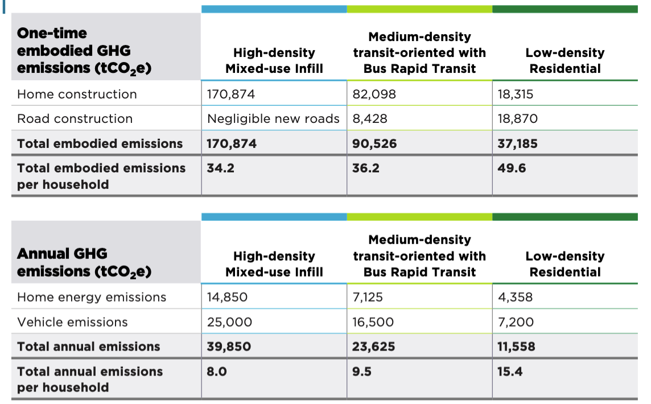
Emissions production comparison
Notes:
Understanding the climate and financial impacts of land-use decisions – Federation of Canadian Municipalities, 2024
https://media.fcm.ca/sites/GMF/resources/Toolkit/understanding-the-climate-and-financial-impacts-of-land-use-decisions.pdf

Slide 112
In summary
High-density mixed-use infill = 42.2 tCO2e
  Moderate to high density housing
  High transit use, low car use, mod to high active trans
  Lowest embodied emissions /household (High in buildings, low in infrastructure) = 34.2 tCO2e
  Lowest annual home and transport emissions = 8
Low-density residential = 65 tCO2e
  Lowdensity housing
  Low transit use, high car use, low active trans
  Highest embodied emissions /household (Low in buildings, high in infrastructure) = 49.6 tCO2e
  Highest annual home and transport emissions = 15.4
Notes:
Understanding the climate and financial impacts of land-use decisions – Federation of Canadian Municipalities, 2024
https://media.fcm.ca/sites/GMF/resources/Toolkit/understanding-the-climate-and-financial-impacts-of-land-use-decisions.pdf

Slide 113
Overall, when compared to lower-density development, higher-density development offers the following:
lower annual GHG emissions per household
lower transportation emissions per household
lower one-time capital costs per household
lower annual operations and maintenance costs per household
higher municipal revenues
more co-benefits, offering better outcomes for social inclusion, physical health/ well-being and walkability
Notes:
Understanding the climate and financial impacts of land-use decisions – Federation of Canadian Municipalities, 2024
https://media.fcm.ca/sites/GMF/resources/Toolkit/understanding-the-climate-and-financial-impacts-of-land-use-decisions.pdf

Slide 114
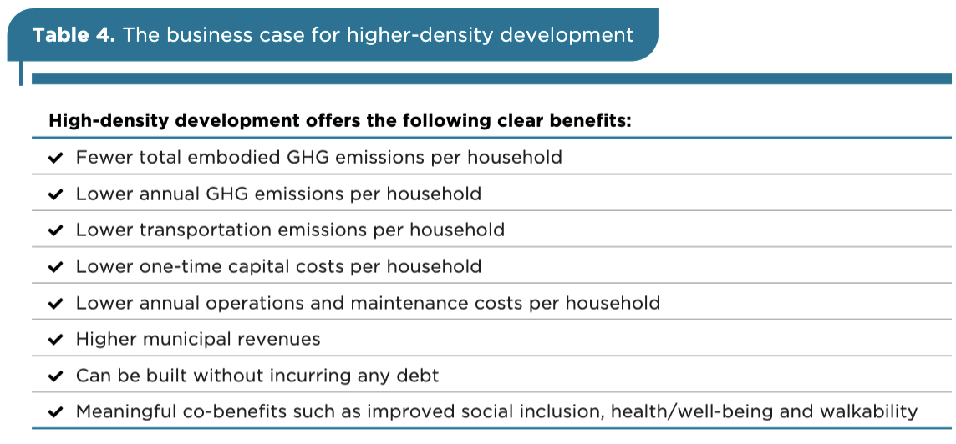
Notes:
Understanding the climate and financial impacts of land-use decisions – Federation of Canadian Municipalities, 2024
https://media.fcm.ca/sites/GMF/resources/Toolkit/understanding-the-climate-and-financial-impacts-of-land-use-decisions.pdf

Slide 115
3 e) Livable Victoria
5 Big Ideas
to make Greater Victoria a more sustainable, vibrant, healthy, and equitable place to live.
1. Scale-up and facilitate the rapid development of social housing across the region.
2. Build an abundance of housing and implement policies to promote affordability.
3. Plan neighbourhoods for sustainability and human well-being, while respecting the planet’s ecological boundaries.
4. Invest in pedestrian, bike-and-roll and transit infrastructure
5. Minimize building waste, energy consumption and greenhouse gas emissions

Slide 116
4. Shouldn’t we be talking about this?
Ideas for deepening democracy

Slide 117
This may be the most difficult thing humanity has ever attempted
Shifting from our current trajectory, making the Great Transition, may just be the most difficult thing humanity has ever attempted. Because our current trajectory seems so good to so many, especially to so many who have it made – and they have not seen or been offered an alternative.

Slide 118
We have to be able to explain
In simple and powerful ways:
How we are failing
Why we are failing
What happens if we don’t change course
What constitutes a better alternative future
How we can change course
What the benefits will be – and to whom – if we do change course.

Slide 119
“We need to reach a social tipping point before we reach a planetary one”
-----
Will Steffen
ANU and
Stockholm Resilience Centre

Slide 120
We need an act of collective imagination
“To build a better future, it’s not enough to bridge divides, we must also re-imagine the systems themselves. That takes more than policy reform. It takes collective imagination as a strategy to envision new ways of organizing our economies, our democracies, and our relationships with one another and the planet.”
Saul Klein, former Dean of Business at UVic, and
Arti Freeman, president and CEO of Definity Foundation,
Times Colonist, 11 July 2025

Slide 121
Conversations for a
One Planet Region
Vision
The Greater Victoria Region achieves social and ecological sustainability, with a high quality of life and a long life in good health for all its citizens, while reducing its ecological footprint to be equivalent to one planet’s worth of bio-capacity.
Mission
The Mission of The Conversations is to establish and maintain community-wide conversations on One Planet living and a One Planet Region.
https://oneplanetconversations.ca

Slide 122
Getting to a
One Planet Region
First we need to learn about it and talk about it with family, friends, neighbours and others
Then we need to imagine it
Then we need to design and build it
  Physical, social, economic and cultural change
Learn – Discuss – Imagine – Design – Create

Slide 123
Future-proofing the Greater Victoria Region
We believe the people, organizations, and leaders in the Greater Victoria Region (GVR) must work together. We need to understand the problems we face and find ways to reduce the stress caused by future events. We must also use our imagination to create a better future.
Conversations for a One Planet Region

Slide 124
A challenge of governance
This is a challenge of governance, which is “the sum of the many ways individuals and institutions, public and private, plan and manage the common affairs of the city”
UN Habitat, 2002

Slide 125
A GVR Futures Council
We propose the creation of a GVR Futures Council that will bring together leaders from key sectors across the GVR.
The Council would be responsible for providing overall strategic direction to a multi-year process of horizon-scanning and widespread public engagement in considering the challenges and potential responses (based on research and experiences elsewhere).

Slide 126
Key sectors that need to be part of the Futures Council
(Regional) government
First Nations
Business
Labour
Civil society
Youth
Diversity community
Faith communities
Academic community
Media

Slide 127
The Process for Conversations
We need a process and a range of opportunities to meet all levels of interest and action. It needs to be:
Multi-year - and indeed, ongoing indefinitely
Multi-nodal - conversations in as many different places as we can
Multi-modal – our preference is for in-person, face-to-face conversation, but we also recognize the value of virtual conversations and conversations via social media.

Slide 128
Techniques for engagement
Dialogue and discussion
Learning about and creating change
Engaging residents in co-design
Innovation and social entrepreneurship
Fostering creative engagement
Recognize and celebrate what is already happening
Creating a ‘Wellbeing Region’ Manifesto and Commission

Slide 129
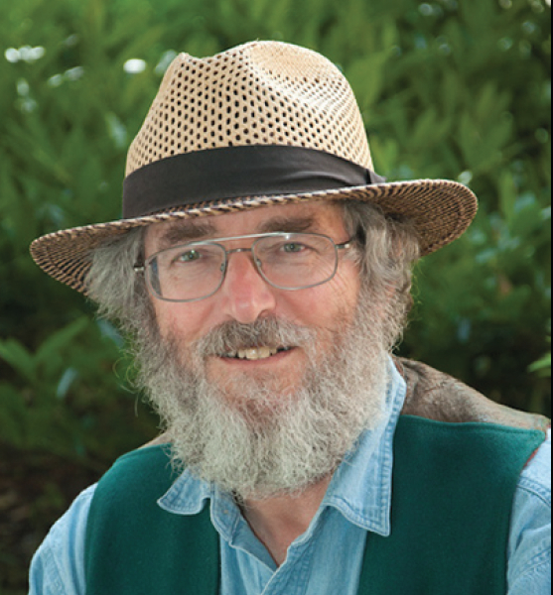
Contact
Dr. Trevor Hancock
Thancock@uvic.ca
Website:
https://trevorhancock.org/

